Slide 1
ABC tDCS Device
Team: Donghyun (David) Seo, Carim-Sanni Sobur, Eric Luu, Radhanath Purakait and Shalih Miah
Sponsor: Dr. Marom Bikson
TA: Jack Twiddy, Evan Azoulay
Faculty Mentor: Alessandra Carriero

Slide 2
Introduction

Slide 3
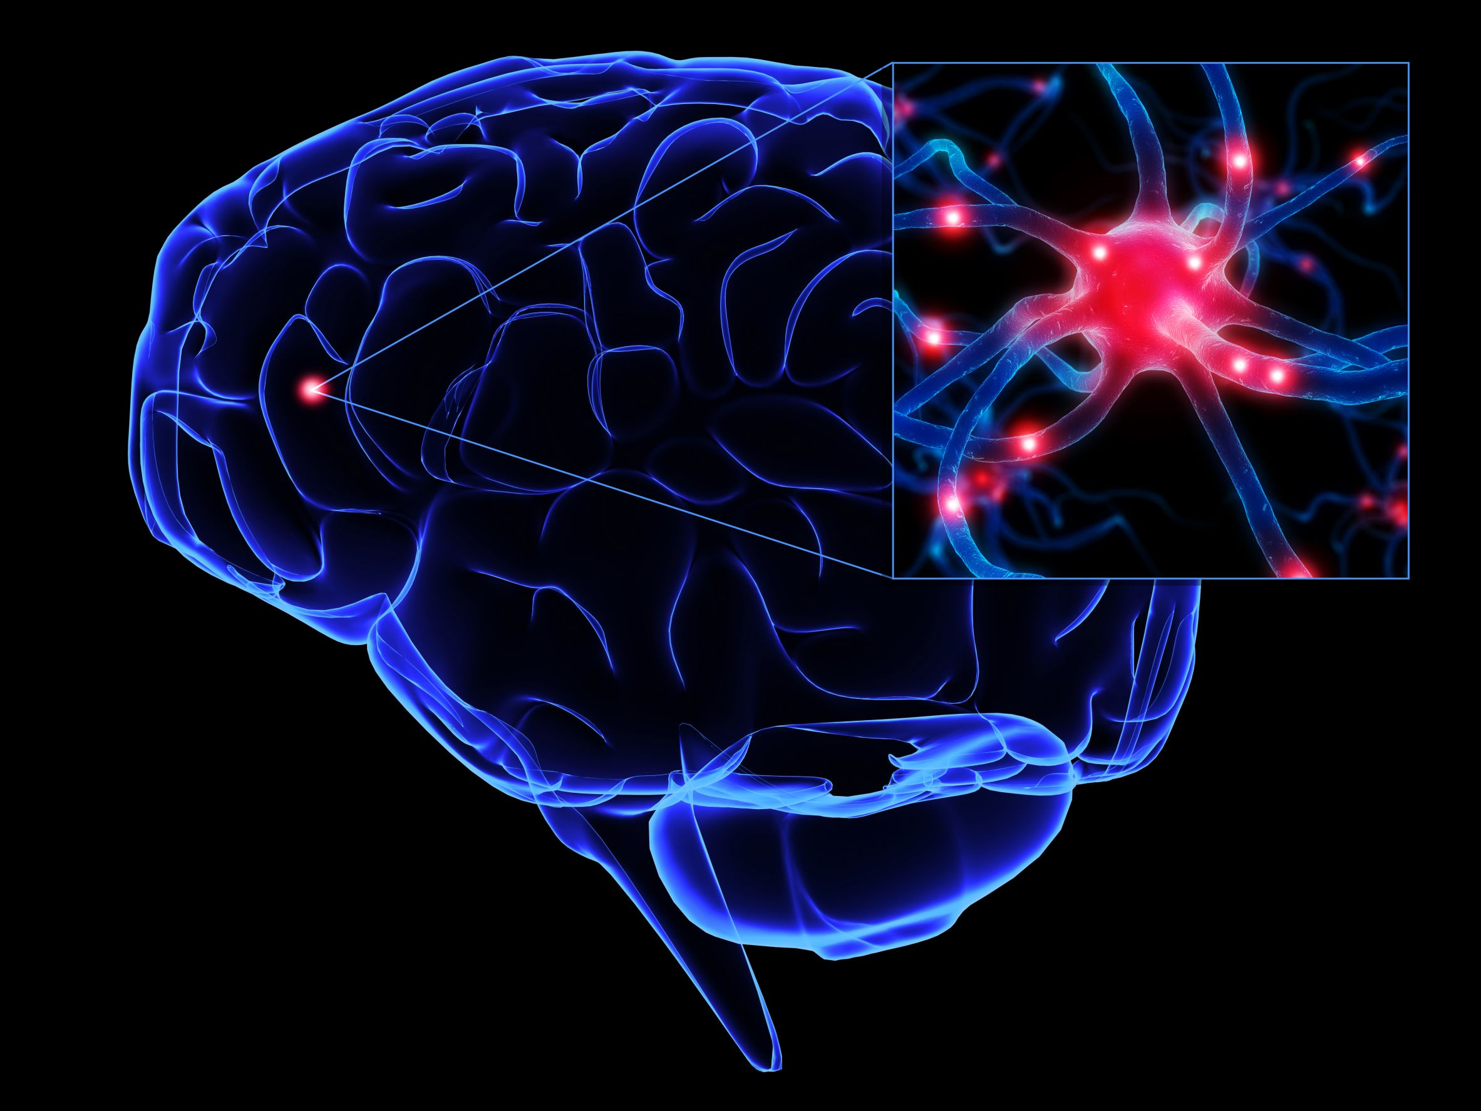
About The Brain
Comprised of network of nerve cells known as neurons [1].
Communicate to each other using tiny electrical, and chemical impulses [1].
Can be stimulated by an electrical current to facilitate the depolarization or hyperpolarization.
https://psychmuseum.uwgb.org/neuro/neurons/
[1] Churchland, Patricia Smith. MIT press, 1989.
Notes:
Shalih

Slide 4
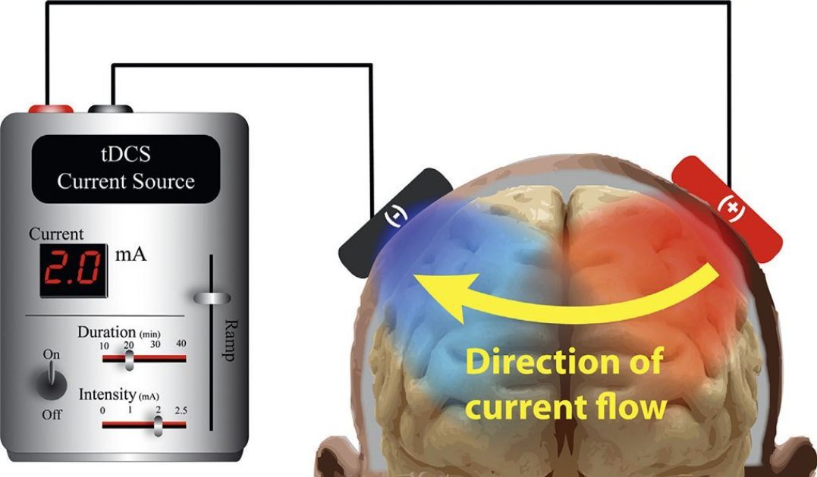
What is tDCS?
Form of neurostimulation where low levels of constant current is applied to the brain.
tDCS can strengthen or weaken the signals between neurons also known as synaptic plasticity [1].
https://caputron.com/pages/what-is-tdcs
[1] Reinhart, Robert MG, et al. Attention, Perception, & Psychophysics 79.1 (2017): 3-23.
Notes:
Shalih

Slide 5
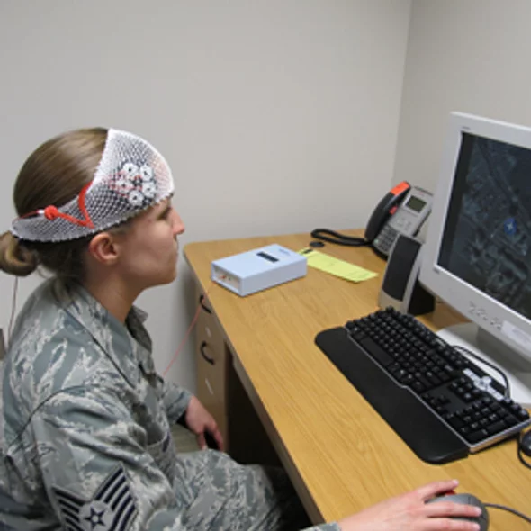
Who uses tDCS?
tDCS can be used in a variety of settings. Used for research in drug addiction [1], enhance a person’s attention span, coordination, memory, and problem-solving ability [2]
Studies have shown that tDCS has very high potential to treat depression, anxiety, PTSD, and chronic pain [2]
https://www.scientificamerican.com/article/amping-up-brain-function/
[1] Shahbabaie A, Hatami J, Farhoudian A, Ekhtiari H, Khatibi A, Nitsche MA.. Frontiers in Pharmacology. 2018;9:907. doi:10.3389/fphar.2018.00907.
[2] “What Is TDCS - Learn About Neurostimulation.” The Brain Stimulator TDCS Devices. Retrieved Oct. 20. 2018, from thebrainstimulator.net/what-is-tdcs/.
Notes:
Shalih

Slide 6
People Affected by tDCS Treatable Conditions
Estimated 40 million adults in U.S. have an anxiety disorder. [1]
Estimated 16.1 million adults in U.S have major depressive disorder. [2]
Estimated 23.4 million adults in U.S. experience chronic pain [3]
About 80 million adults can be treated by tDCS
[1] “Facts & Statistics.” Anxiety and Depression Association of America, ADAA. Retrieved Oct. 21. 2018, from adaa.org/about-adaa/press-room/facts-statistics.
[2] “Depression.” Anxiety and Depression Association of America, ADAA. Retrieved Oct. 20. 2018, from adaa.org/understanding-anxiety/depression.
[3] “NIH Analysis Shows Americans Are In Pain.” National Center for Complementary and Integrative Health, U.S. Department of Health and Human Services, 11 Aug. 2015, nccih.nih.gov/news/press/08112015.
Notes:
Shalih

Slide 7
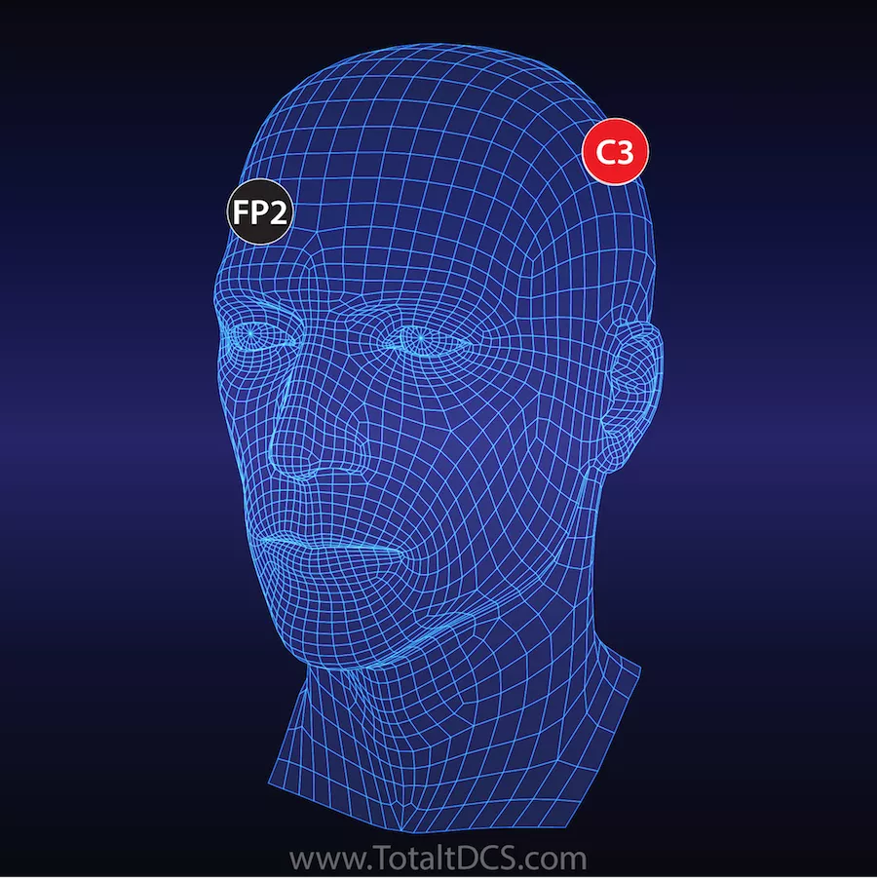
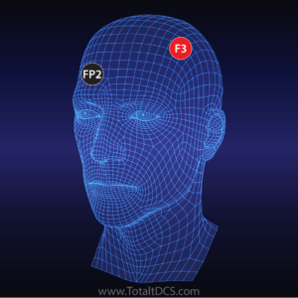
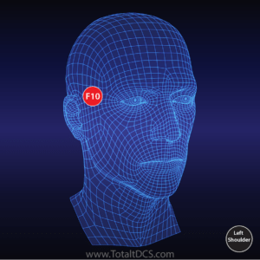
tDCS Montages
Montages are the position of electrodes
Different montages for desired treatments
Reduces chronic pain
Treating depression and anxiety
Accelerated learning
Notes:
Shalih

Slide 8
Problem and Need Statement

Slide 9
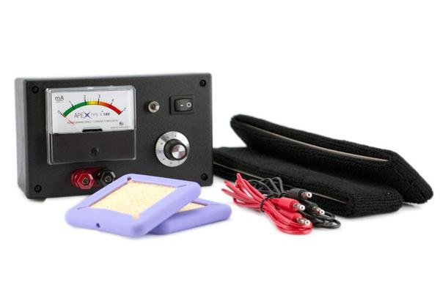
Current Problem
Most devices in the market are expensive ($30 - $400)
Extra cost for more features
Requires prior set up and is hard to use
Incorrect electrode placement can cause adverse effects
Bulky and not disposable
https://caputron.com/products/apex-type-a-tdcs-device?variant=5427100024894
Notes:
Eric

Slide 10
Need Statement
To find a way to make a low cost, easy to use tDCS device that can be disposed after a single dose (30~45 minutes).
Notes:
Eric

Slide 11
Project Specifications
Notes:
David

Slide 12
Project Design Specification
Parameter | Value
Electrode size | 25 cm^2 for 2 milliamp current (0.8 A/m² current density) [1]
Current | 2 mA - 4 mA (safety threshold) [2]
Voltage requirement | 20 V - 43 V [4]
Duration | 30 - 45 minutes [2]
Dosage | Single dose
Headgear circumference | Around 57.2 cm [3] (elastic material)
Weight | Less than 0.5 lb
Price | 20 USD
Ramp up/Ramp down | 1 mA for 30 seconds
Brunoni AR, Nitsche MA, Bolognini N, et al. Clinical research with transcranial direct current stimulation (tDCS): challenges and future directions. Brain Stimul. 2011;5(3):175-195.
Thair H, Holloway AL, Newport R and Smith doi: 10.3389/fnins.2017.00641
Neyzi O, Bundak R, Gökçay G, et al. nical Research in Pediatric Endocrinology. 2015;7(4):280-293. doi:10.4274/jcrpe.2183.
DIY | DIY Tdcs | Page 2." Diytdcs.com. N. p., 2015. Web. 15 Oct. 2018.
Notes:
David

Slide 13
Prior Art

Slide 14
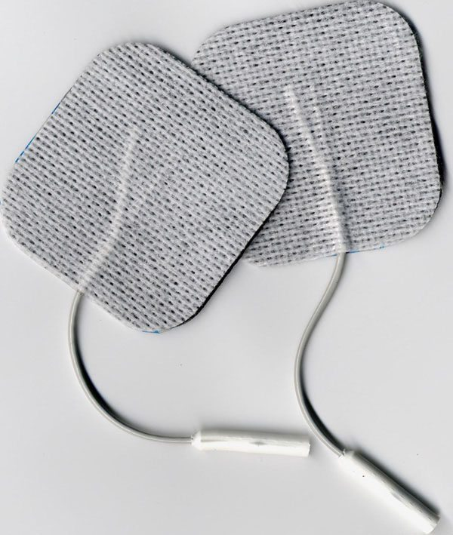
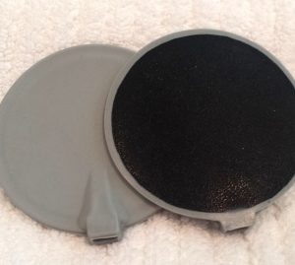
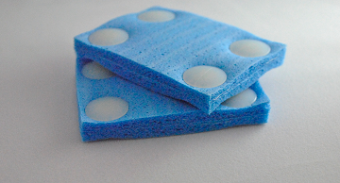
Adhesive Electrode
Carbon Electrode
Sponge Electrode
Cheapest type
Easy to prepare
Designed for direct skin contact
Not useable for hair
Most expensive type of electrode
Harder to prepare
specific conductive gel
Highest impedance
Allows current flow through the hair.
Sponge material absorbs electrolyte easily
Requires a conductive rubber insert
Notes:
Eric

Slide 15
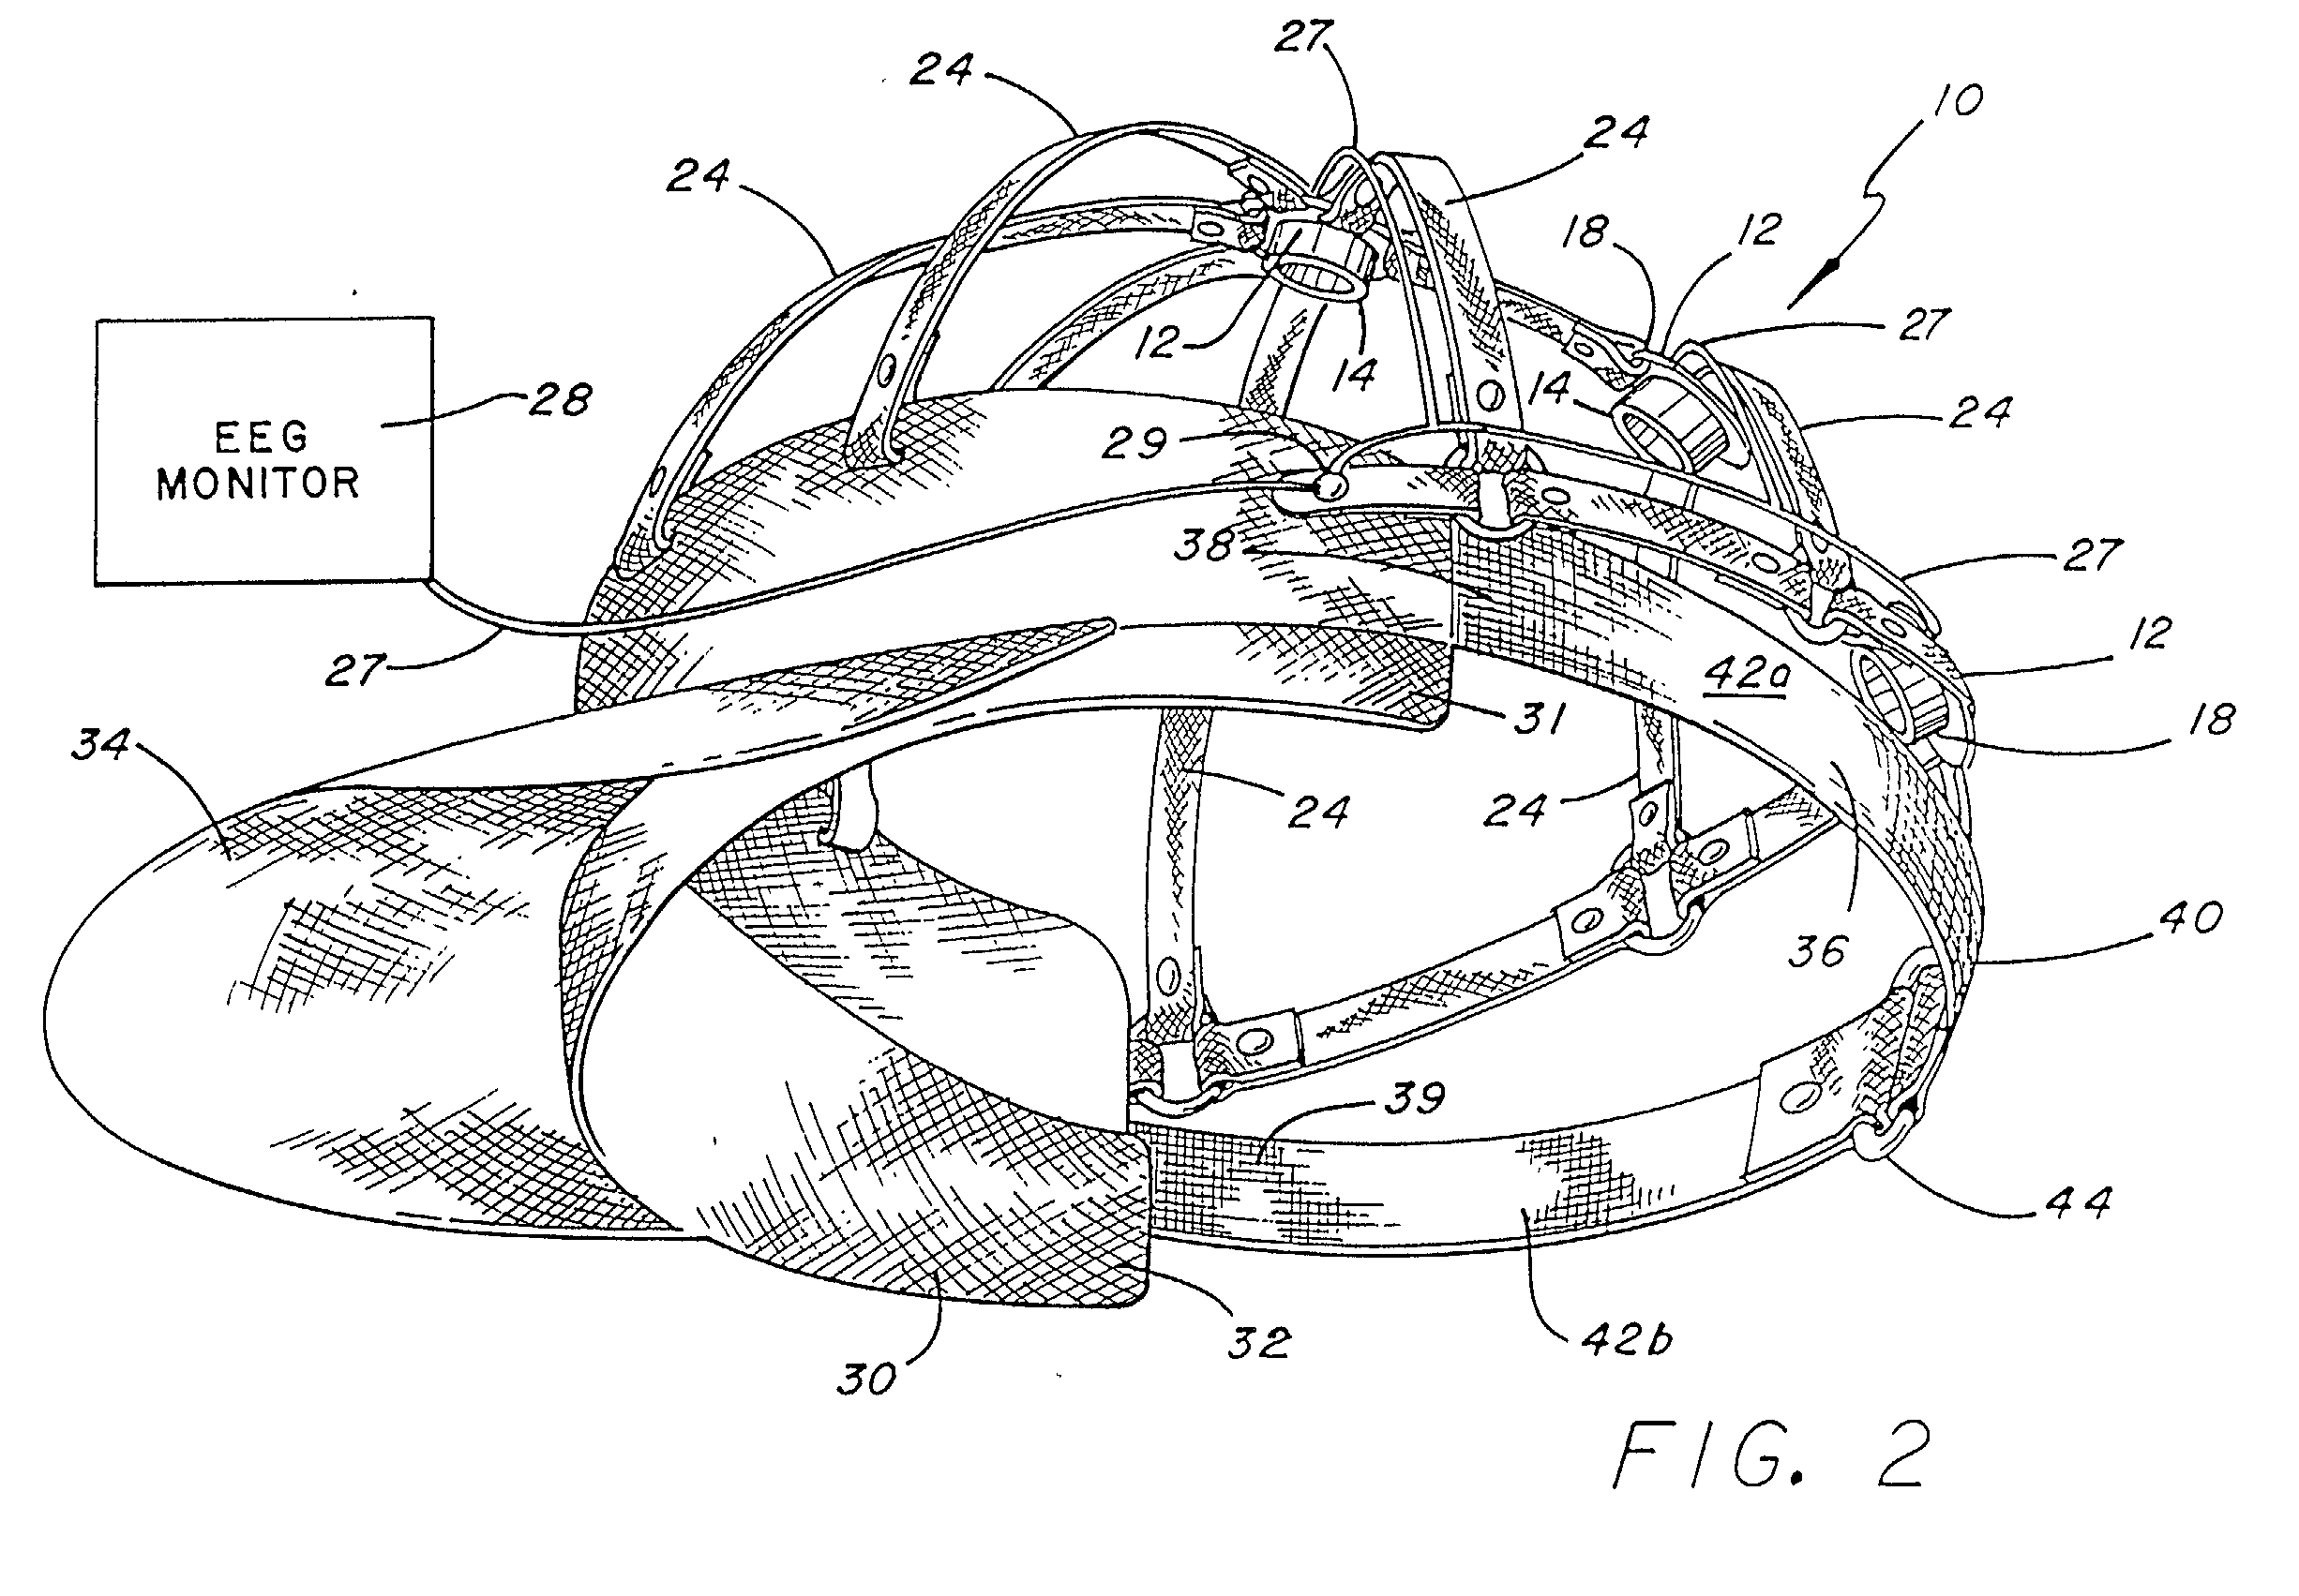
EEG Electrode Locator Headgear Patent
Headgear has adjustable straps to correctly place electrodes
Cons: Too many adjustable options it is less convenient to use and setup
Headgear is collapsible and portable
A thin flexible plastic with plastic fasteners could be cheap and disposable
https://patents.google.com/patent/US20020029005A1/en?q=(headgear)&q=(electrodes)&status=APPLICATION&oq=(headgear)+(electrodes)+status:APPLICATION
[1] Levendowski, Daniel, et al. Portable EEG Electrode Locator Headgear. Patent No. US20020029005A1. 7 Mar. 2002.
Notes:
Eric

Slide 16
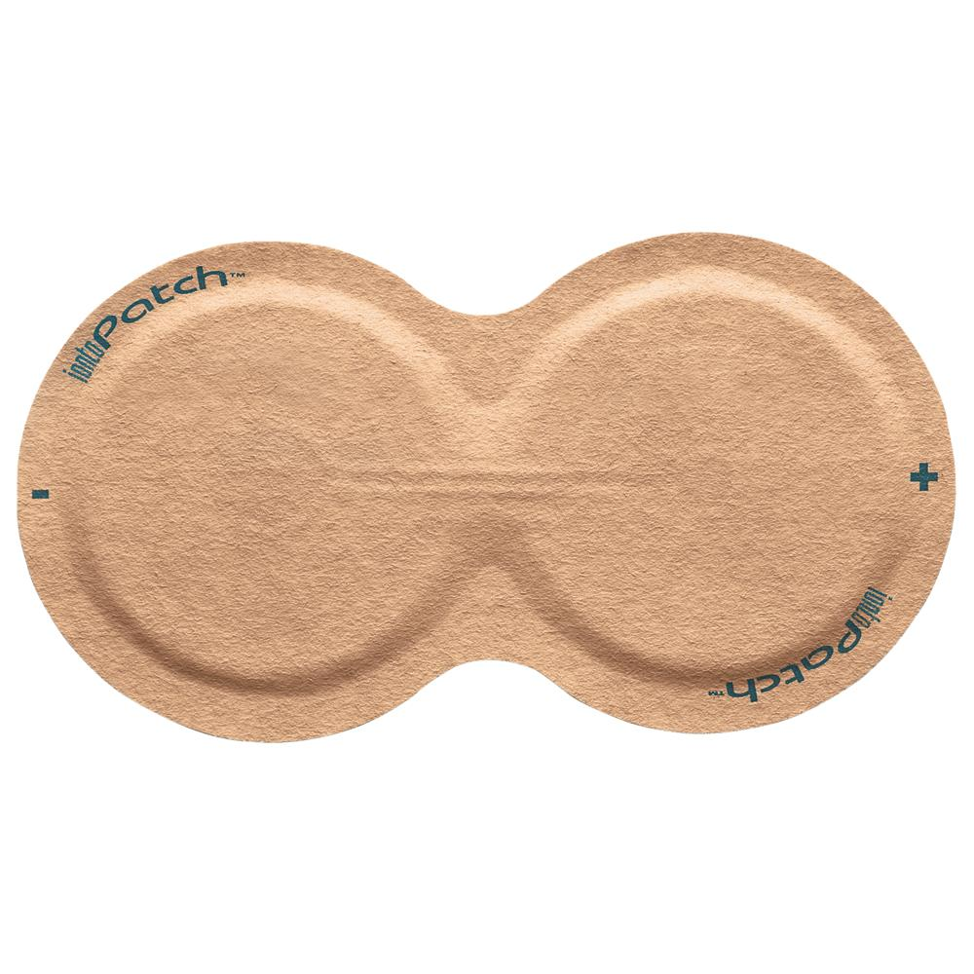
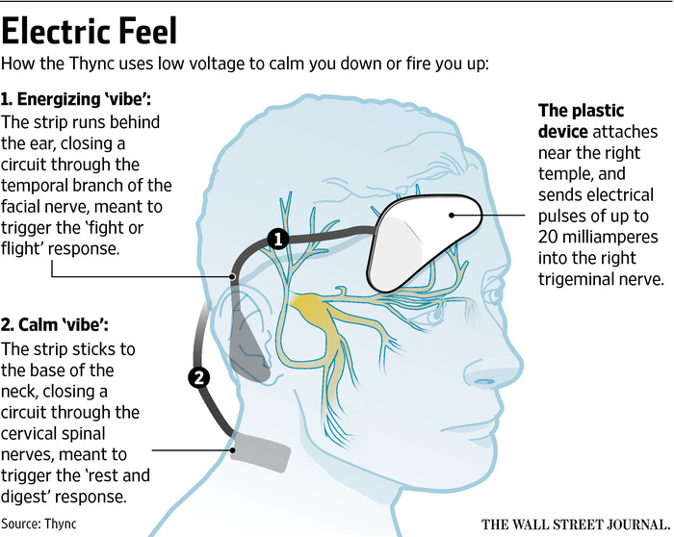
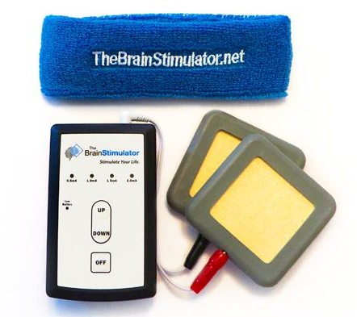
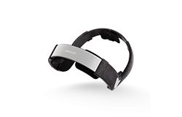
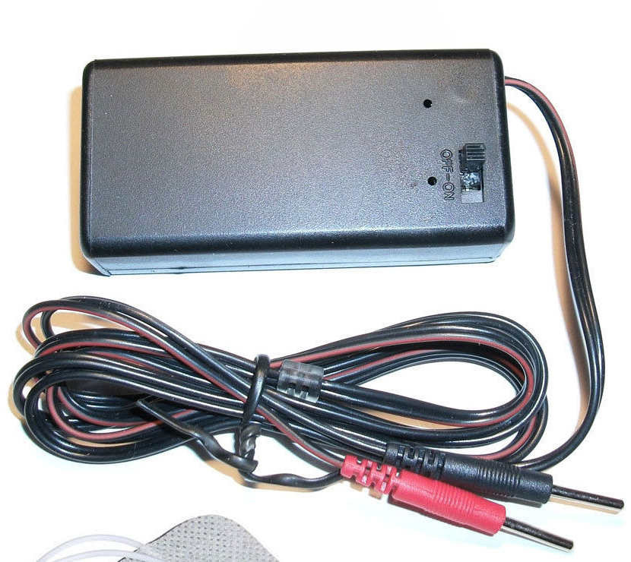
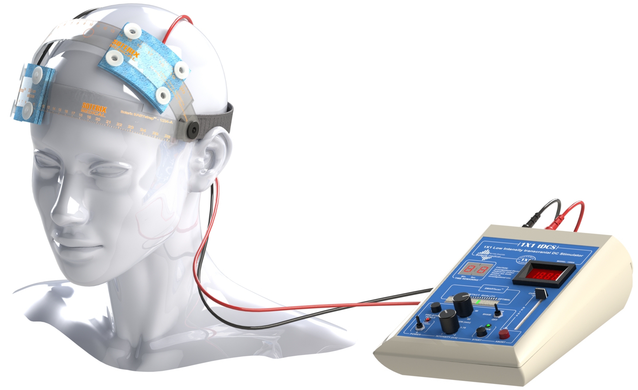
Name / criteria | Iontopatch 80 | Brain Stimulator V3 | Thync | Soterix Medical 1 X 1 | PlatoWork | White market tDCS
Price | $57 per 6 | $130 | $250 | N/A | $450 | $30
Max Current | 0.09 mA | 2 mA | N/A | 2 mA | 2 mA | 1 mA
Auto Ramp up/down | ✘ | ✔️ | ✔️ | ✔️ | ✔️ | ✘
Timer | ✘ | ✔️ | ✔️ | ✔️ | ✔️ | ✘
WaveForms | DC | DC | Pulse | DC | DC | DC
FDA-Cleared | ✘ | ✘ | ✔️ | ✘ | ✘ | ✘
Session Duration | 14 hours | 30 Minutes | 20 minutes | 40 minutes | 15 minutes | N/A
Notes:
Carim

Slide 17
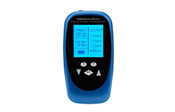
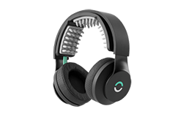
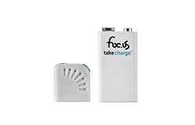
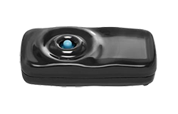
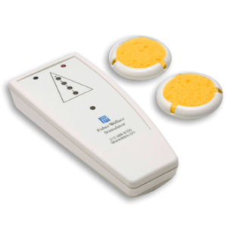
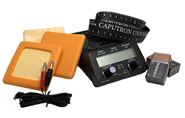
Name/ criterial | Activadose tDCS Device | Focus V3 | Brain Driver | Focus Go flow 4 | Halo | Fisher Wallace Stimulator (CES)
Price | $324.99 | $374.99 | $129.99 | $244 | $499 | $699
Max Current | 4 mA / 2 mA | 2 mA | 2 mA | 4 mA | 2 mA | 4 mA
Auto Ramp up/down | ✔️ | ✔️ | ✔️ | ✔️ | ✔️ | N/A
Timer | ✔️ | ✔️ | ✔️ | ✔️ | ✔️ | ✔️
WaveForms | DC | DC, AC, RN, Pulse, Ripple | DC | DC, soDC | DC | AC, Pulse
FDA-Cleared | ✔️ | ✘ | ✘ | ✘ | ✘ | ✔️
Duration | 40 minutes | 40 minutes | 20 / 30 minutes | 35 minutes | 20 minutes | 20 minutes
Notes:
Carim

Slide 18
Project Design Specification | Activadose tDCS Device | Focus V3 | Brain Driver | Focus Go flow 4 | Halo | Fisher Wallace Stimulator (CES) | Our tDCS Device
Price | $324.99 | $374.99 | $129.99 | $244 | $499 | $699 | $20
Max Current | 4 mA / 2 mA | 2 mA | 2 mA | 4 mA | 2 mA | 4 mA | 2mA
Output Voltage |  |  |  |  |  |  | 43 v
Auto Ramp up/down | ✔️ | ✔️ | ✔️ | ✔️ | ✔️ | N/A | ✔️ 1mA 30 second
WaveForms | DC | DC, AC, RN, Pulse, Ripple | DC | DC, soDC | DC | AC, Pulse | DC
Electrode type
Duration | 40 minutes | 40 minutes | 20 / 30 minutes | 35 minutes | 20 minutes | 20 minutes | 20/40 minutes
weight |  |  |  |  |  |  | 2lb
Notes:
Carim

Slide 19
Limitations
Device | Limitations
EEG Electrode Locator Headgear | The device needs a little more work for people with hair. Requires the application of saline before use.
Iontophoresis | Uncertainty of constant voltage and output current. Also requires application of saline before use.
Soterix Medical 1x1 device | The device is expensive and not disposable.
Thync Device | The device is expensive and not disposable.
White Market tDCS devices | They are not disposable, not a lot of features quality is not trustworthy.
The Brain Stimulator v3.0 | Expensive and requires a bit of expertise to set up which is prone to mistake by an individual.
Table 1: limitations of prior art
Notes:
carim

Slide 20
Intellectual Property Claims

Slide 21
Intellectual Property Claims
Device will be disposable
Device will be easy to use
Patient should be able to self administer the medication
Device will come in easy to open packaging
It will be ready to use and pre assembled inside packaging
Headgear should easy to put on
Device should output a steady current of 2 - 4 mA depending on the type of device used
The device should be usable for single 30-45 minute dose, then safely deactivated
Notes:
David

Slide 22
Concept Selection Process

Slide 23
Brainstorming map
Power supply
disposability
Low cost, ready to use, “disposable” tDCS
Batteries in series for higher voltage
Wireless power supply (AC)
headgear
Cap headgear
10-20 3v coin cell batteries
2-6 9v battery
Strapped headgear
plastic gear
Circuit design
Charged capacitor buck converter
Pulse current amplifier
electrodes
Premade straps
carbon
Goal 14.5-18.5v
1.5 mA to 2.5 mA
20-43v in market
Sponge
Collapsible headgear
Porous Prong
Constant current amplifier
Use a transistor to regulate
cheap
adhesive
too expensive
User adjustable strap
cheapest but doesn't work for hairy skin
Use an op amp to produce constant current
Use a voltage regulator to regulate
presoaked
Notes:
Rad

Slide 24
Concept 1: strap headgear + transistor circuit + power supply
2 mA
This strap headgear design requires some assembly but it is the most straightforward design
The circuit uses a transistor to manage constant current
Disposable headgear if strap material is cheap
Circuit is one button operation
amperage
Cost is cheap because circuit is built for just one current setting
Cost/disposability
usability
Duration is managed using a 555 timer as with other designs we will design it to turn on on button push
Low cost, Ready to use, Disposable tDCS
duration
Should cost about 10$
Ramp up/down
Performed with additional circuit (op amp integrator)
electrodes
and then turn off in after
40 minutes
30s/1mA
4cm by 4cm
Sponge electrode for comfort
Notes:
Rad

Slide 25
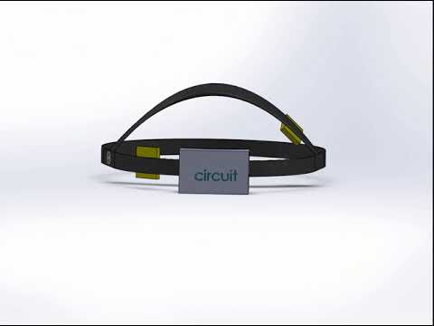
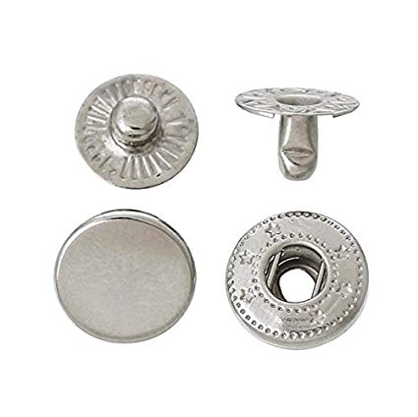
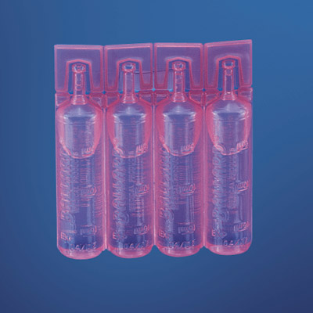
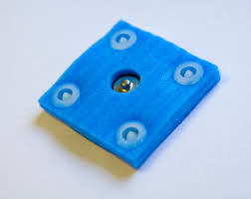
Concept 1
DC supply using a BJT transistor circuit.
High voltage power source
Metal conductive snaps
A timing circuit will be used consisting of a 555 timer
Ramp up and ramp down using an integrator type circuit
Strap material will be semi flexible
Dry electrodes snap onto the headgear to be soaked
Notes:
Rad

Slide 26
Concept 2: Cap headgear + DC current
Headgear
Cap headgear
Cost
Sponge electrodes will be already attached to the cap. The electrodes will have small opening where saline can be poured.
Less than $20
DC current
Low cost, easy to use tDCS
Circuit
Duration
20 minutes
2 mA
Circuit is one button operation
usability
Sponged electrodes already attached
Timing can be managed with a microcontroller
Ramp up/down and timer
This cap headgear design requires no assembly
ATtiny or 8 bit microcontroller
Notes:
Carim

Slide 27
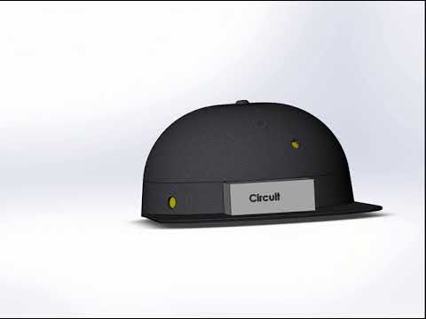
Concept 2
Hat with 2 Electrodes (disposable).
Wires are attached to the conductive “snap on” pins.
Carbon rubber snap electrodes inside the sponges are attached to the conductive snap on pins.
Circuit box
DC current
Uses atmega chip
Electrode are pre snapped on the pin.
Small opening for saline
"Ballard Unit Dose Saline 0.9% Sodium Chloride Solution, 15Ml Vial, 144/Cs | Medex Supply." Medexsupply.com. N. p., 2018. Web. 2 Dec. 2018.
Notes:
Carim

Slide 28
Concept 3: plastic headgear + coin cell batteries + sponge electrode
expensive
Snap sponge
Salinate bottle
Works on the hairline
Fixed to position
electrode
disposable
Snap strap
duration
30 mins
Low cost, Ready to use, Disposable tDCS
Depression/anxiety
montages
headgear
circuit
Constant current
2 mA
Ramp up/down
3 V coin cell batteries
Power consumption
User
friendly
Not disposable
In series
Electrode on plastic headgear
One button stimulation
Limited settings
Notes:
David

Slide 29
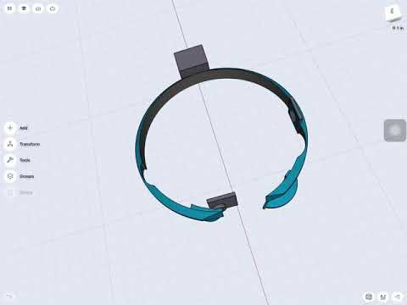
Concept 3
Strap with 2 disposable snap electrodes.
Carbon rubber snap electrodes inside the sponges are attached to the conductive snap-on pins.
Circuit box
DC current
Ramp up/down
The headgear cannot positioned on the exact target area due to different head sizes and shapes.
"Snappad™ – 1X1-Accessories – Soterix Medical." Soterixmedical.com. N. p., 2018. Web. 11 Dec. 2018.
Notes:
David

Slide 30
Concept 4: Cap Headgear + Prong electrodes + 4 9V Battery
Headgear with electrodes fully disposable
Cost around $20 - $35
Prong electrode has to be customly manufactured
Increase cost
Fully Disposable
Cap is low cost
Cost
Circuit is low cost
Circuit disposable
Disposability
30 minutes
Low cost, ready to use, “disposable” tDCS
Duration
Ramp up/down
using two op amps in integrator circuit
Circuit
Press button to start stimulation
Circuit attached to cap
Electrode
Usability
Constant current
Prong electrode
Electrode comes set up in the correct montage
Electrodes require soaking with tap water
Pre-salted just add water to make saline solution

Slide 31
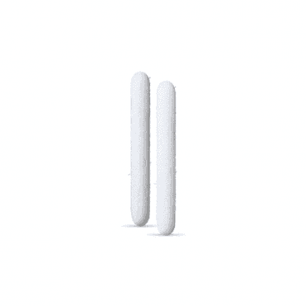
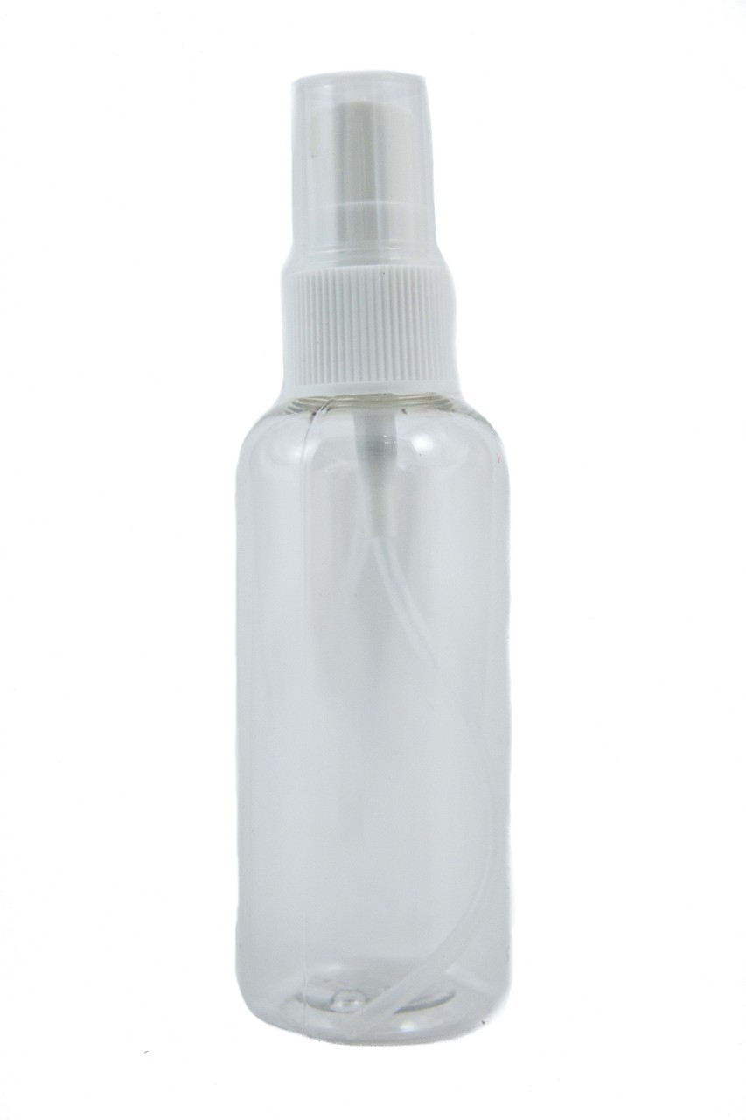
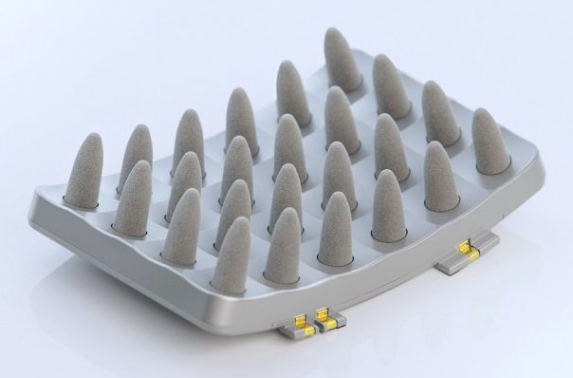
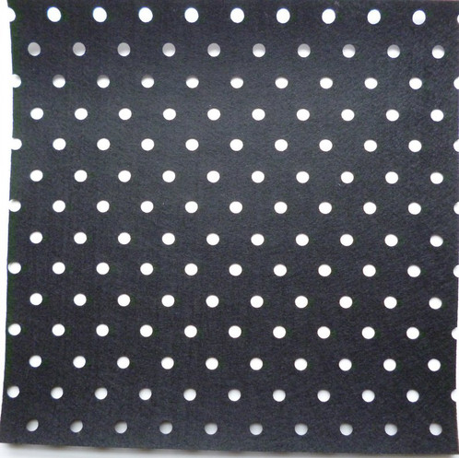
Concept 4
Hat with two electrodes on the depression montage
Electrode comes pre attached
Attached via snap
Prong electrode
Marker replacement tip
Felt
Spray bottle
Circuit Box
DC
Two op amp for ramp up/down
Integrator circuit

Slide 32
Selection Matrix
Criteria | weight | Concept 1 | Concept 2 | Concept 3 | Concept 4 | Brain stimulator v3.0
Ease of use | 3 | 1 | 1 | 1 | 1 | 0
Low Cost | 5 | 1 | 1 | 1 | 1 | 0
Environmental effect | 1 | 0 | 0 | 0 | 0 | 0
Disposability | 4 | 1 | 1 | 1 | 1 | 0
Ergonomics | 3 | -1 | 1 | -1 | -1 | 0
Waveform | 3 | 1 | 1 | 1 | 1 | 0
Weighted sum |  | 12 | 18 | 12 | 12 | :0
Notes:
Rad

Slide 33
Price for selected concept
Components | Unit Price | quantity | Price
Hat | $ 0.88 | 1 | $ 0.88
Circuit box | $ 1.50 | 1 | $ 1.50
Microcontroller | $ 0.44 | 1 | $ 0.44
Power source (Battery design) | $ 1.00 (Duracell) | 4 | $ 4
Power source (voltage up circuit) | $ 9.99 (from amazon Drok brand) | 1 | $ 9.99
Saline Vial | $ 0.50 (15 mL) | 3 | $ 1.50
Sponge electrode | $ 4 | 2 | $ 8
Snap on pins | $.08 | 2 | $ 0.16
Total |  |  | 16.48 / 26.48
https://www.amazon.com/Converter-DROK-Transformer-Constant-Current/dp/B075DFBTRM
Notes:
Rad

Slide 34
References
Churchland, Patricia Smith. Neurophilosophy: Toward a unified science of the mind-brain. MIT press, 1989.
Reinhart, Robert MG, et al. "Using transcranial direct-current stimulation (tDCS) to understand cognitive processing." Attention, Perception, & Psychophysics 79.1 (2017): 3-23.
Mondino, Marine, et al. "Transcranial direct current stimulation for the treatment of refractory symptoms of schizophrenia. Current evidence and future directions." Current pharmaceutical design 21.23 (2015): 3373-3383.
Shahbabaie A, Hatami J, Farhoudian A, Ekhtiari H, Khatibi A, Nitsche MA. Optimizing Electrode Montages of Transcranial Direct Current Stimulation for Attentional Bias Modification in Early Abstinent Methamphetamine Users. Frontiers in Pharmacology. 2018;9:907. doi:10.3389/fphar.2018.00907.
Bachtiar V, Johnstone A, Berrington A, et al. Modulating Regional Motor Cortical Excitability with Noninvasive Brain Stimulation Results in Neurochemical Changes in Bilateral Motor Cortices. The Journal of Neuroscience. 2018;38(33):7327-7336. doi:10.1523/JNEUROSCI.2853-17.2018.
Ciechanski, P., et al. "Effects of transcranial direct‐current stimulation on laparoscopic surgical skill acquisition." BJS Open 2.2 (2018): 70-78.
Choe, Jaehoon, et al. "Transcranial direct current stimulation modulates neuronal activity and learning in pilot training." Frontiers in human neuroscience 10 (2016): 34.
Sample, Ian. "US Military Successfully Tests Electrical Brain Stimulation To Enhance Staff Skills." the Guardian. N. p., 2016. Web.15 Oct. 2018.
Manders, Eric. Handboek neurologische communicatiestoornissen. Maklu, 2016.

